Slide 1
PHYSICS 4 FINAL REVIEW

Slide 2
Hình thức thi final
Thi online.
Thời gian: 13h 16/6 (T4) – 13h 18/6 (T6)
Nộp trên Blackboard section Assignment
Hình thức làm: Viết tay ra giấy A4
Định dạng file nộp: PDF (chỉ 1 file duy nhất)
Tên file: Name_MSSV_FinalP4_06-2021.pdf

Slide 3
Lưu ý!!
Sai định dạng sẽ bị điểm 0. Vd: nộp file Word, nộp nhiều file, nộp hình ảnh, nộp file zip,…
Nộp trễ sẽ bị điểm 0.
Sai đề (mã group) sẽ bị điểm 0.

Slide 4
Lưu ý phụ
Viết rõ ràng, không làm tắt.
Ghi họ tên, MSSV, ký tên ở đầu bài.
Nộp trễ nhất 15p trước deadline để tránh bị lỗi.
Kiểm tra mail thông báo Outlook sau khi nộp. Nếu không có mail thông báo là bài chưa được nộp.

Slide 5
Content
Wave Optics: Thin lenses
Quantum: All except tunneling
Atomic: Bohr atom, Hydrogen atom
Relativity and Nuclear: Special theory of relativity, Nuclear, Radioactivity

Slide 6
CHAPTER 2 WAVE OPTICS

Slide 7
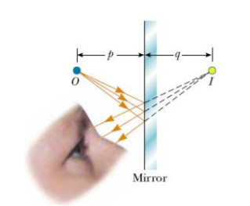
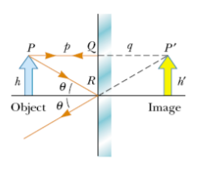

1. Mirrors:
p: Distance from object to mirror
p > 0: Real object
p < 0: Virtual object
q: Distance from image to mirror
q > 0: Real image
q < 0: Virtual image
Lateral magnification:

Slide 8
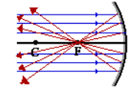
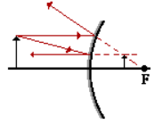
1. Mirrors:
Concave mirror:
Focal point F: The place where beams of light are focused onto. Focal length f > 0.
Can create real and virtual images.
Convex mirror:
Focal point F: The place where beams of light originate.
Focal length f < 0.
Can only create virtual images.

Slide 9
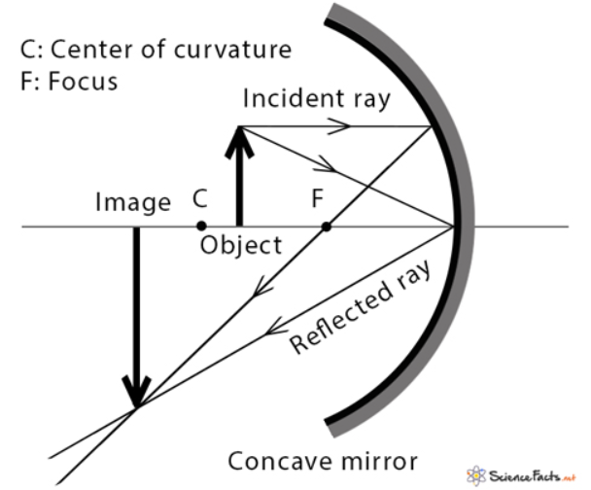
1.1. Concave mirrors:
Image formation:
All parallel rays go through the focal point F.
Rays that go to the center of the mirror get reflected back.
Rays that go through center of curvature C are reflected back on themselves.
-> All these rays meet at the top of the image.
Therefore, need at least 2 rays to form an image.

Slide 10
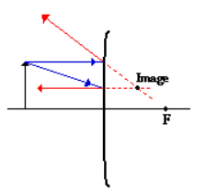
1.2. Convex mirrors:
Image formation:
All parallel rays go through the focal point F.
Normal rays get reflected parallel to the axis.
Rays that go through center of curvature C are reflected back on themselves.
-> All these rays meet at the top of the image.
Therefore, need at least 2 rays to form an image.

Slide 11
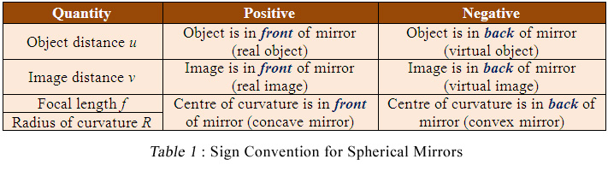
1.3. General convention for mirrors:

Slide 12
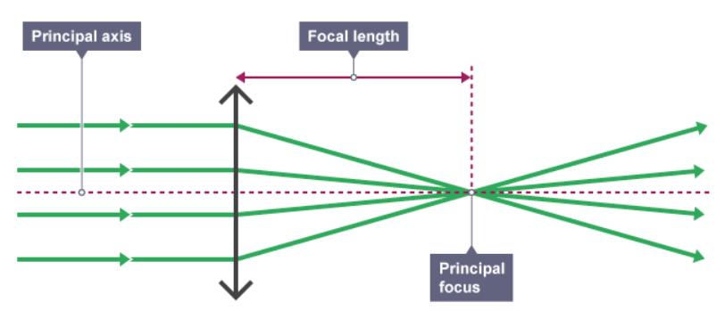
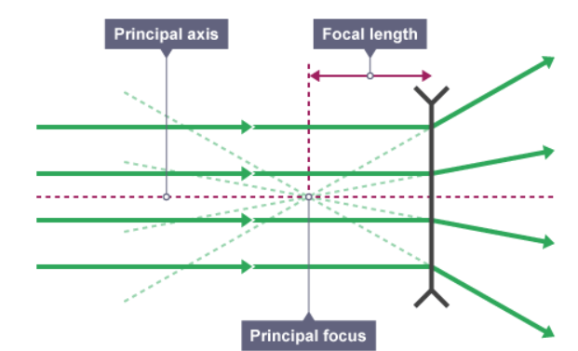

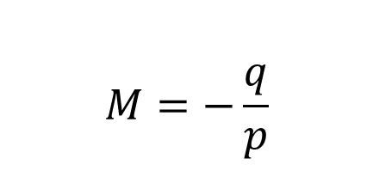
2. Thin lenses:
Converging lens: f > 0
Diverging lens: f < 0
Thin lenses equation:
Lateral magnification:

Slide 13
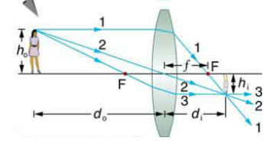
2.1. Converging lens:
Can form real and virtual images.
Image formation:
All parallel rays go through the focal point F at the other side.
Rays that go through the center maintain the same direction
Other rays become parallel at the other side.
-> All these rays meet at the top of the image.
Therefore, need at least 2 rays to form an image.

Slide 14
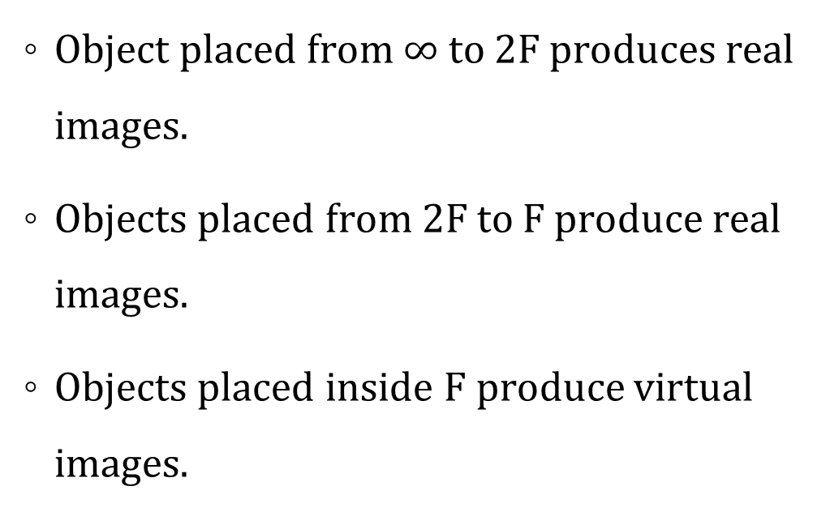
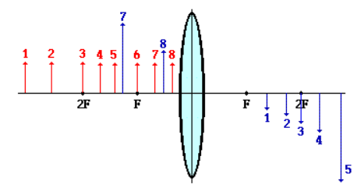
2.1. Converging lens:
Image formation:

Slide 15
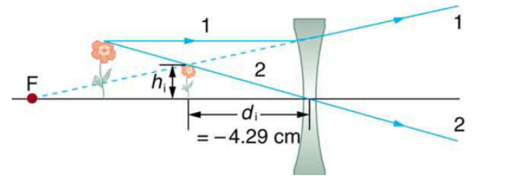
2.2. Diverging lens:
Can only form virtual images.
Image formation:
All parallel rays go through the focal point F at the same side.
Rays that go through the center maintain the same direction.
Other rays become parallel at the other side.
-> All these rays meet at the top of the image.
Therefore, need at least 2 rays to form an image.

Slide 16
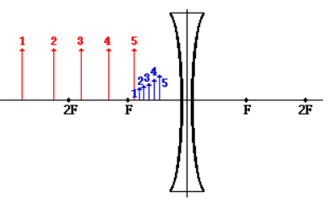
2.2. Diverging lens:
Image formation:
All real objects produce virtual images.

Slide 17
The projection lens in a certain slide projector is a single thin lens. A slide 24.0 mm high is to be projected so that its image fills a screen 1.80 m high. The slide-to-screen distance is 3.00 m.
Determine the focal length of the projection lens.
How far from the slide should the lens of the projector be placed so as to form the image on the screen?

Slide 18
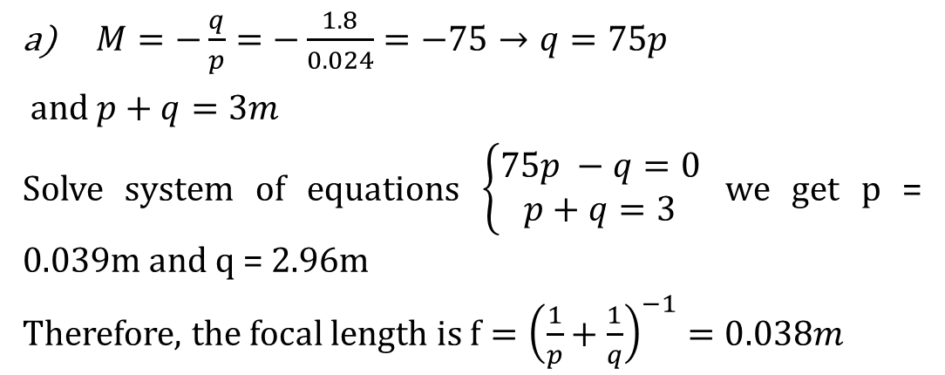

Solution:
“Image fills screen” -> Real image -> Only converging lens
Therefore, q > 0 and f > 0
0.024m
1.8m
b) q = 2.96m
3m

Slide 19
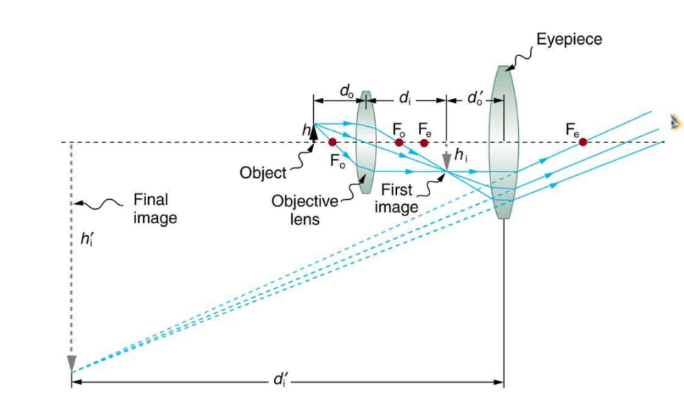
2.3. Applications:
Microscope:
Includes two converging lenses.
Has two focal lengths: f_{o} of objective lens and f_{e} of eyepiece lens.
First image is real and becomes real object for eyepiece lens.
Final image is virtual, enlarged and flipped.

Slide 20
Calculate the magnification of an object placed 6.20 mm from a compound microscope that has a 6.00 mm focal length objective and a 50.0 mm focal length eyepiece. The objective and eyepiece are separated by 23.0 cm.

Slide 21
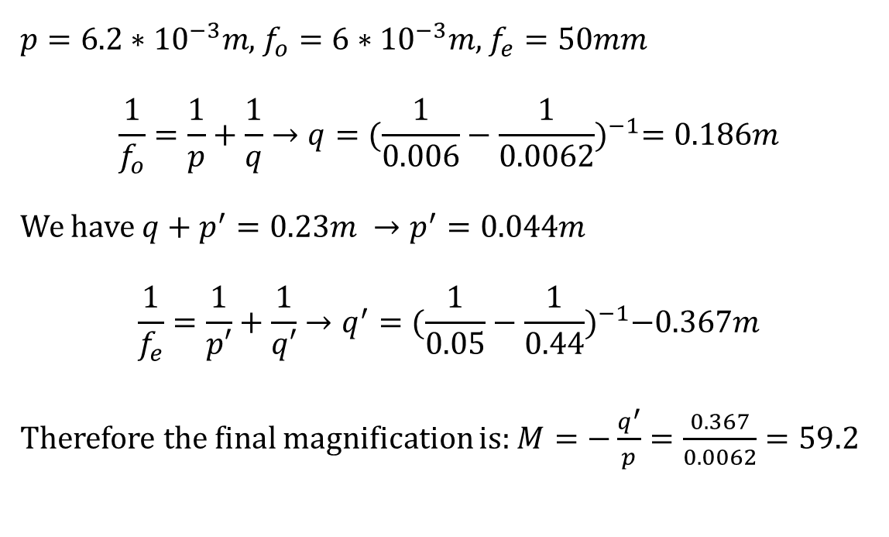
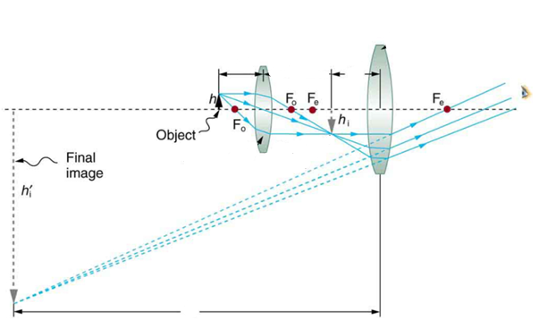
Solution:
p
p’
q
q’

Slide 22
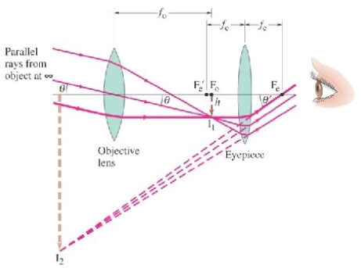
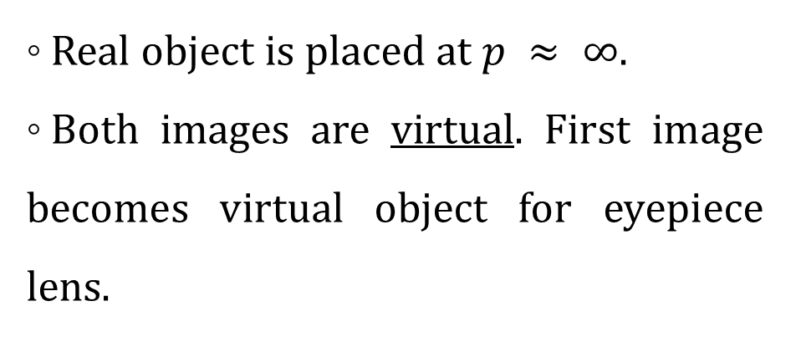
2.3. Applications:
Telescope:
Includes two converging lenses.
Has two focal lengths: f_{o} of objective lens and f_{e} of eyepiece lens.

Slide 23
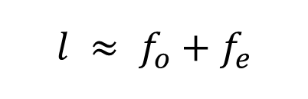
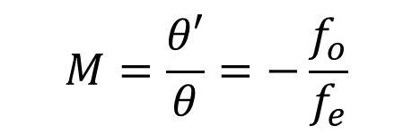
2.3. Applications:
Telescope:
Length of the telescope: From objective piece to eyepiece.
Magnification:

Slide 24
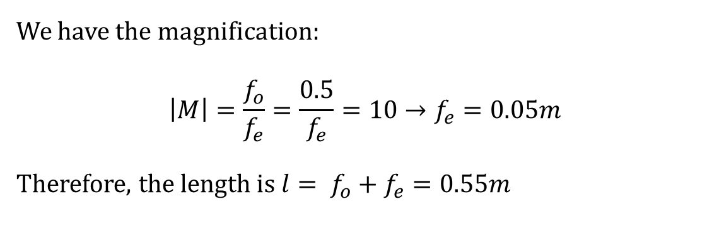
Solution:
A student constructs an astronomical telescope with a magnification of 10. If the telescope has a converging lens of focal length objective 50cm, what is the focal length of the eyepiece? What is the resulting length of the telescope?

Slide 25
CHAPTER 3 INTRO TO QUANTUM PHYSICS

Slide 26
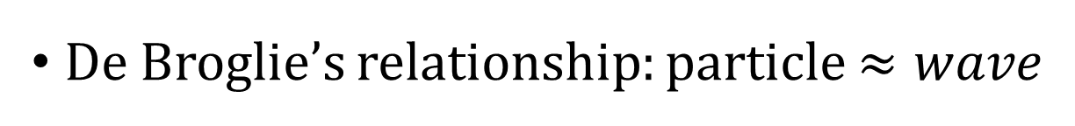
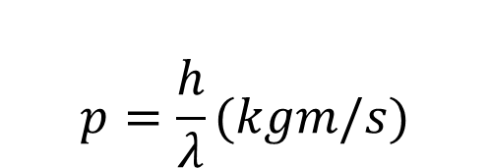
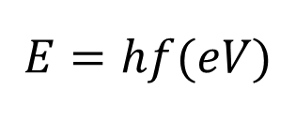
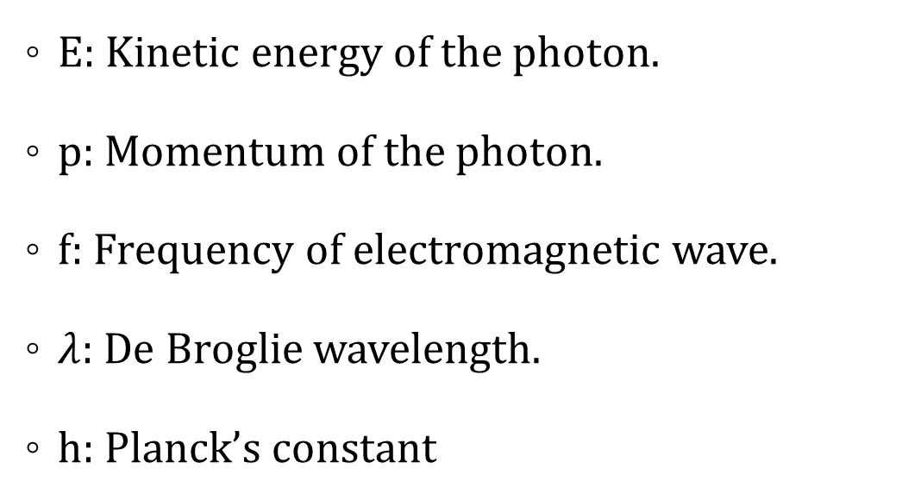
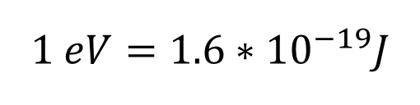
1. De Broglie’s theory

Slide 27
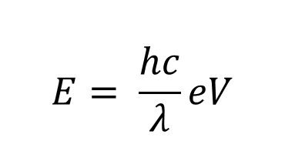
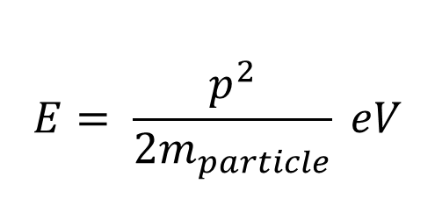
1. De Broglie’s theory
For photons:
For other particles:

Slide 28
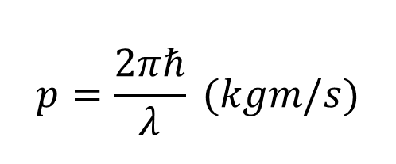
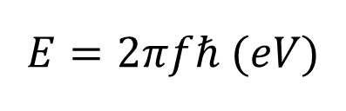
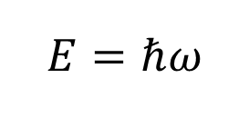
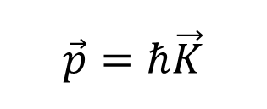
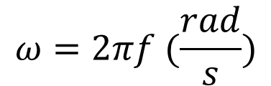
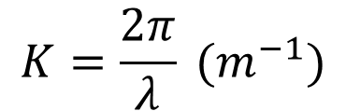
1. De Broglie’s theory
Planck – Einstein’s relationship:
with:
and

Slide 29

2. Schrodinger’s equation:
Wave function:
Doesn’t have physical meaning.
Probability density:
Probability of finding the particle in small volume space.

Slide 30
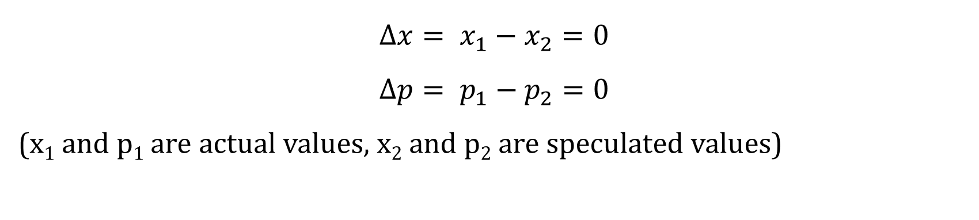

3. Heisenberg’s uncertainty principle:
General principle:
If momentum is specified, position is unspecified and vice versa.
Specified position and momentum:
Unspecified position and momentum:

Slide 31


3. Heisenberg’s uncertainty principle:
General principle:
Uncertainty for energy:
If the energy is specified, then the lifetime of that particle is unspecified and vice versa.

Slide 32
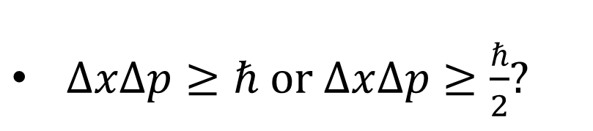
3. Heisenberg’s uncertainty principle:

Slide 33
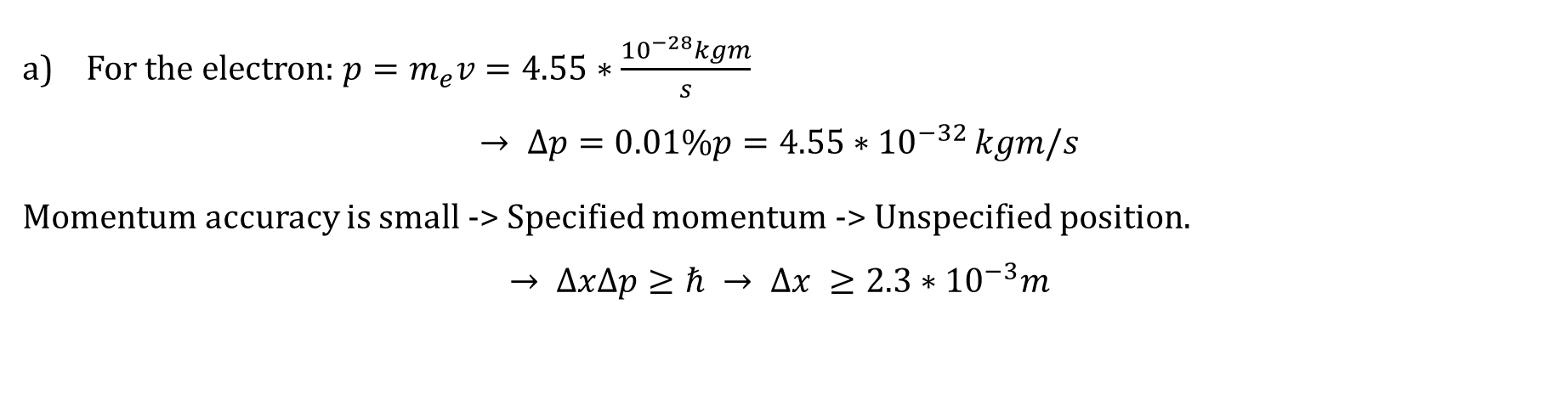
Solution:
An electron and a 0.0200 kg bullet each have a velocity of magnitude 500m/s, accurate to within 0.0100%. Within what lower limit could we determine the position of each object along the direction of the velocity?

Slide 34
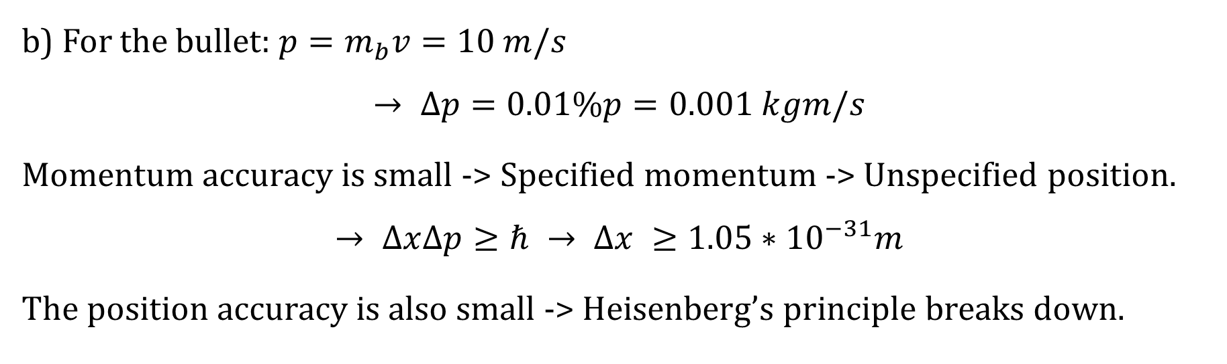
Can’t use Heisenberg’s principle for large objects.

Slide 35
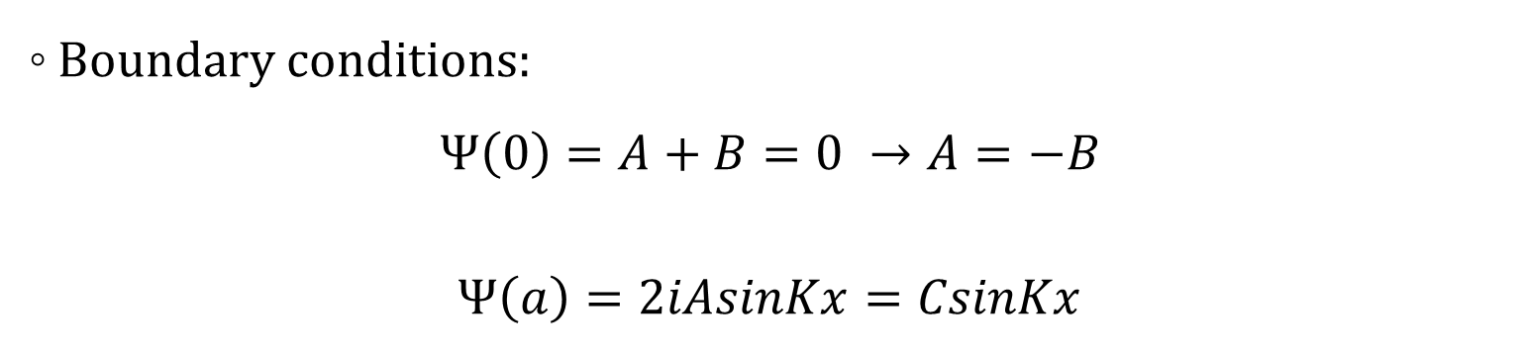
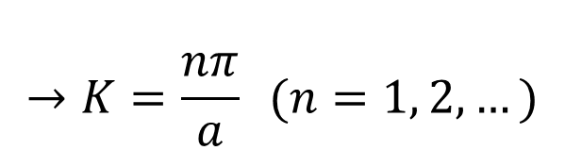
4. Particles in a square well:
Wave function:
= 0

Slide 36
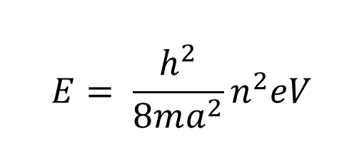
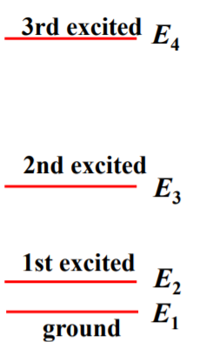
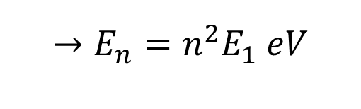
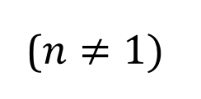
4. Particles in a square well:
Energy levels of particle: n = 1 is the lowest excited state (ground state)
a: Position of the particle (m)
n: Energy level/quantum number
Moving up a level -> Light is absorbed.
Moving down a level -> Light is emitted.

Slide 37
A certain atom has an energy level of 2.58 eV above the ground level. Once excited to this level, the atom remains in this level for 1.64 x 10⁻⁷s before emitting a photon and returning to the ground level.
a) What is its wavelength? What is the color of this light?
b) What is the smallest possible uncertainty in energy (in eV) of the photon?

Slide 38
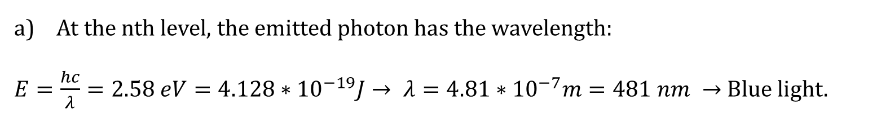
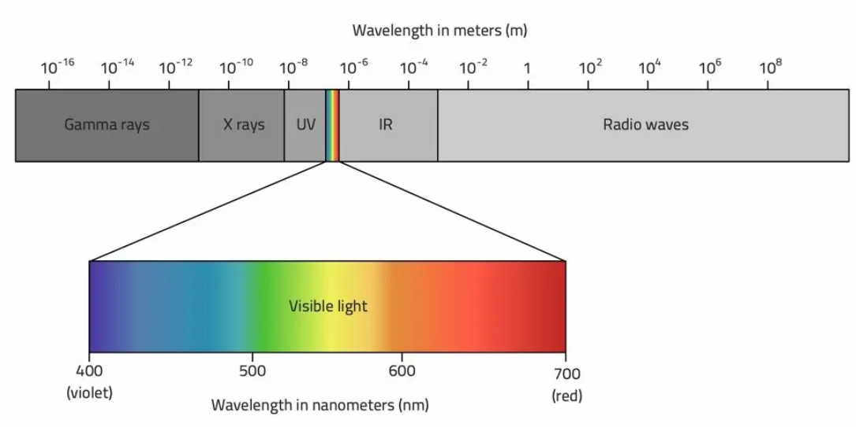
Solution:

Slide 39
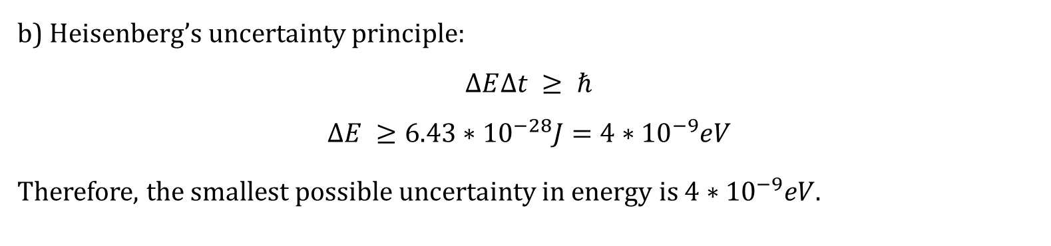
Solution:

Slide 40



4. Particles in a square well:
Normalization condition:
-> The probability of finding a particle in all space:

Slide 41


Slide 42

Solution:

Slide 43

Solution:

Slide 44


Slide 45


Solution:

Slide 46
CHAPTER 4 ATOMIC PHYSICS

Slide 47


1. Bohr atom:
Energy of a hydrogen atom is quantized -> Energy levels.
n = 1, 2, 3...: Principle quantum number
Spectral emission lines:
f_{mn}: Frequency of the photon emitted/absorbed when jumping from M to N (Hz)

Slide 48


1. Bohr atom:

Slide 49

1. Bohr atom:
E₁ (Lyman series): Ultraviolet light
E₂ (Balmer series): Visible light
E₃ (Paschen series): Infrared
E₄ (Brackett series): Near-infrared

Slide 50


1. Bohr atom:

Slide 51


Slide 52


Solution:

Slide 53



2. Schrodinger’s equation for H atom:
Wave function for ground state (n = 1):
Wave function for first excited state:

Slide 54


Slide 55


Solution:
b)

Slide 56
CHAPTER 5 RELATIVITY AND NUCLEAR

Slide 57


1. Special theory of relativity:
Time dilation:
Observers measure the time of something to be slower if it’s moving relative to them.
For example, a muon decays with a mean lifetime of 2.2*10⁻⁶s measured when it’s at rest. If a muon moves at 0.999c relative to the Earth, an observer on Earth would measure its lifetime to be 15.6*10⁻⁶s.

Slide 58


1. Special theory of relativity:
Length contraction:
Observers measure the length of something to be shorter when it’s moving relative to them.
For example, a spaceship at rest measured to be 400m. When it’s moving at 0.99c relative to the Earth, an observer on Earth measures it to be 56.4m.

Slide 59
Your starship passes Earth with a relative speed of 0.999c. After traveling 10 years (your time), you stop at lookout post LP13, turn, and then travel back to Earth with the same relative speed. The trip back takes another 10 years (your time). How long does the round trip take according to measurements made on Earth?
(Neglect any effects due to the accelerations involved with stopping, turning, and getting back up to speed.)

Slide 60

Solution:

Slide 61


2. Nuclear physics:
Nuclei properties of :

Slide 62

2. Nuclear physics:
Reaction energy: Q = (M_{A} + M_{B} – M_{C} – M_{D})c²
Q > 0: Reaction releases energy.
Q < 0: Reaction absorbs energy.

Slide 63


Slide 64

Solution:

Slide 65


2. Nuclear physics:
Radioactivity:

Slide 66



2. Nuclear physics:
Half-life: The amount that is half a lifetime of an atom.

Slide 67
The radioactive nuclei ¹⁹⁹Pt has a half-life of 30.8 minutes. A sample is prepared that has an initial activity of 7.56 x 10¹¹ Bq.
a) How many ¹⁹⁹Pt nuclei are initially present in the sample?
b) How many ¹⁹⁹Pt are present after 30.8 minutes? What is the activity at this time?

Slide 68

Solution:

